Slide 1
Aims of this session:
As a parent you will:
Have accessible, accurate, up-to-date, information.
Know that your child is safe and supported.
Have information on how and when RHE is taught.
Understand your rights and responsibilities in relation to our RHE policy and curriculum.
Be informed about issues of confidentiality and how it affects you and your children.
Have your views and ideas received in a respectful, non-judgemental manner.
Notes:
1. With the aim of reporting annually

Slide 2
New DfE statutory guidance
Came into effect in September 2020
Relationships and Health Education in primary schools
This guidance is for all primary schools.
However, some of the Y5 and Y6 science curriculum form part of what is viewed as sex education - puberty and scientific parts of reproduction:
describe the life process of reproduction in some plants and animals, including humans
describe the changes as humans develop to old age
Notes:
describe the life process of reproduction in some plants and animals, including humans
-describe the changes as humans develop to old age

Slide 3
Why teach RHE?
PSHE education has proven impact on life chances and academic success when delivered well
Statutory RSHE requirements can have a major impact on the quality of PSHE in all schools for all pupils.
These developments mean that all pupils can benefit from an education that keeps them safe, healthy and prepared for the realities of modern life.
An extensive 2017 literature review by leading economists found ‘Very strong evidence’ that PSHE (personal, social, health and economic) learning has a positive impact on health, well being and academic attainment.
“The evidence shows that personal, social, health and economic (PSHE) education can improve the physical and psychosocial well-being of pupils. A virtuous cycle can be achieved, whereby pupils with better health and well-being can achieve better academically, which in turn leads to greater success.”
Department for Education review of PSHE education impact and effective practice

Slide 4
Why teach RHE?
We teach RHE on the understanding that:
  it is taught in the context of family life;
  it is part of a wider process of social, personal, spiritual and moral education;
  children should be taught to have respect for their own bodies;
  children should learn about their responsibilities to others;
  it is important to build positive relationships with others, involving trust and respect, both in person and online;
  it makes a significant contribution to our duty to safeguard and protect all children;
  it plays a key role in improving health outcomes for children and young people such as risk-taking behaviour, including online behaviour

Slide 5
Do I have a right to withdraw my child from Relationships and Health Education?
No.
Relationships, Health Education, including Mental Health are statutory and parents cannot withdraw their child from these lessons.
Parents also cannot withdraw their child from aspects of Relationships and Health Education which are covered as part of the statutory science curriculum.
The Government believe the contents of these subjects, such as family, friendship, safety (including online safety) are important for all children to be taught.
Sex Education is not statutory in primary schools and we will not be implementing this beyond the Science curriculum.

Slide 6
What does the statutory guidance cover?
The Department for Education statutory guidance for Health Education, Relationships Education and RSE outlines what schools must cover.
This covers broad areas of particular relevance and concern to children and young people today. It should ensure that every child is guaranteed a PSHE education that covers mental health and wellbeing, physical health (including healthy lifestyles and first aid) and learning about safe, healthy relationships, including understanding consent and negotiating life online.

Slide 7
Rationale: What do we want to achieve as a school?
Our school’s overarching aims for our pupils are:
to foster pupil wellbeing and develop resilience and character that we know are fundamental to pupils being happy, successful and productive members of society.
to know how to be safe, including online.
to be healthy both mentally and physically.
to be able to manage their academic, personal and social lives in a positive way.
to demonstrate personal attributes including kindness, integrity, generosity, honesty, respect and tolerance in order to contribute to adult life in British society.
understand how the Equality Act 2010 relates to them as a child and through adult life, to recognise and challenge any form of discrimination.

Slide 8
Content proposed within the curriculum
Relationships | Health and mental well- being | Other foci Living in the Wider World – Beyond DFE framework
Families and people who care for me Caring friendship Respectful friendships Online Relationships Being Safe | Mental Well being (6 steps to wellbeing) Internet Safety and Harm Physical health and fitness (including healthy eating) Drug, alcohol and tobacco Health and prevention (including people who help us, and looking after ourselves) Basic First Aid Changing Adolescent Body | Economic Well being Enterprise Careers (Not included in new statutory framework)

Slide 9
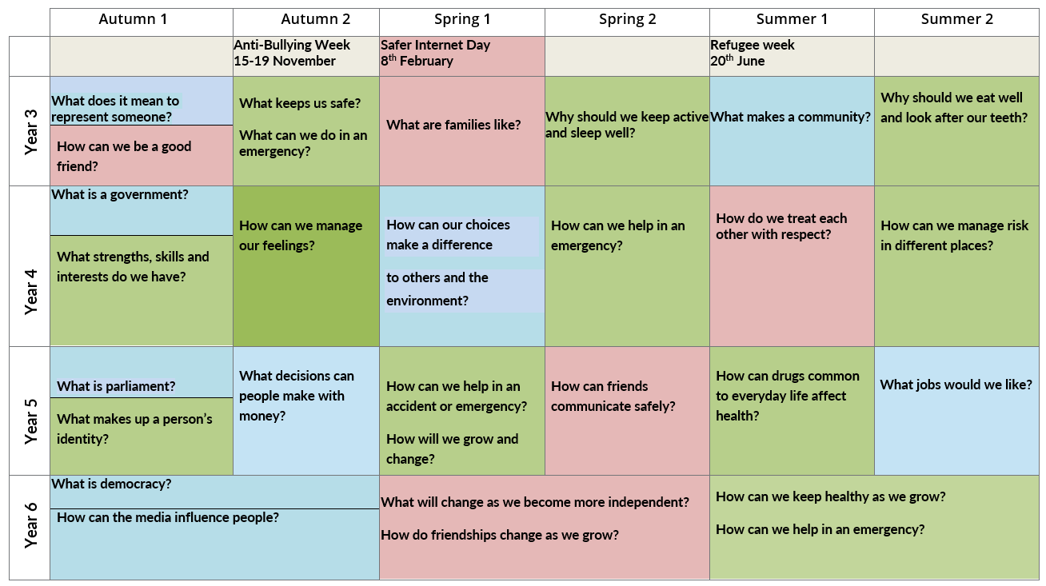

Slide 10
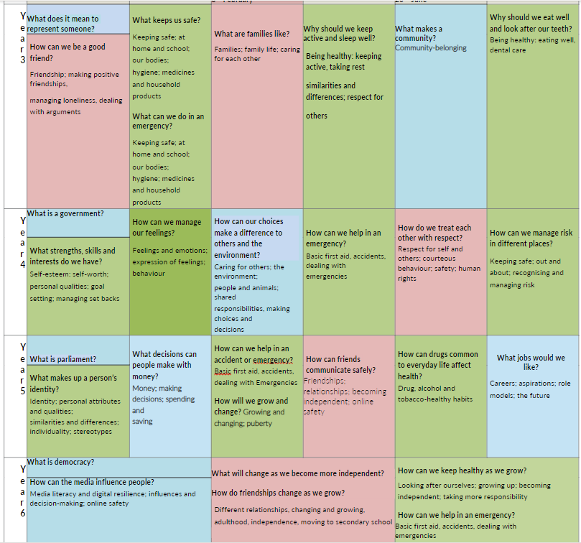

Slide 11
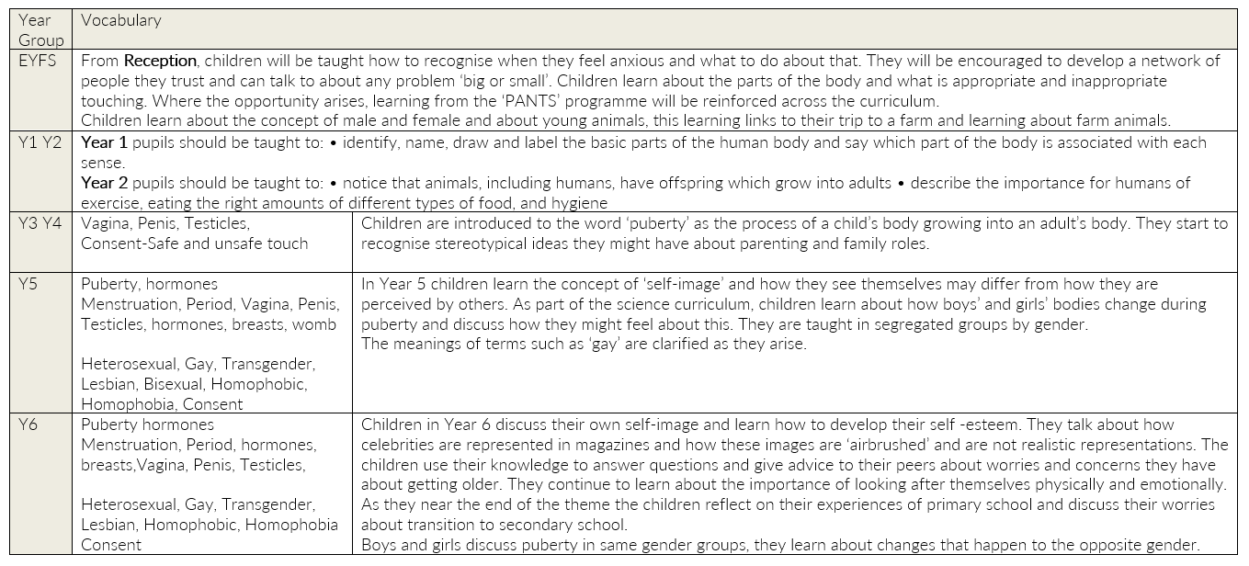

Slide 12
Teaching about puberty is considered a key safeguarding issue by Ofsted. As Janet Palmer HMI (Ofsted’s PSHE lead) has said:
“If pupils are kept ignorant of their human, physical and sexual rights… they are not being adequately safeguarded. When inspecting schools … inspectors are guided to check that the sex education in national curriculum science at Key Stages 1-3 is being adequately taught; and that primary schools have regard to the Department for Education statutory guidance on teaching pupils about puberty before they experience the onset of physical changes.”
“Inspectors leading Section 5 inspections have been guided to grade behaviour and safety separately and to take whichever is the lowest grade as the overall grade for the Behaviour and Safety strand of the Section 5 inspection framework; and if Behaviour and Safety are judged to require improvement this is likely to affect the grade for overall effectiveness.”

Slide 13
Sensitivity
Teachers of RHE have received inhouse training so they are equipped to deliver the planned curriculum.
Sensitive and potentially difficult issues will arise in RHE as children will naturally share information and ask questions. When spontaneous discussion arises, it will be guided in a way which reflects the stated school aims and curriculum content for RHE. As a first principle we will answer questions relating to the taught planned curriculum for that age group to the whole class.
We will answer questions relating to areas beyond the taught planned curriculum for that age group, in a sensitive and age appropriate way only to the child or children who have asked the question, where appropriate in consultation with a child’s parent. If a member of staff is uncertain about the answer to a question, or indeed whether they wish to answer it they will seek guidance from myself or the Head Teacher.
When answering questions, we shall ensure that sharing personal information by adults, pupils or their families is discouraged. Where a question or comment from a pupil in the classroom indicates the possibility of abuse, teachers will pass this information to the designated person for child protection in line with school policy.

Slide 14
What is the Equality Act (2010)?
The Equality Act 2010 states that it is against the law to discriminate against anyone because of:
Age
Disability
Gender reassignment
Marriage or civil partnership
Pregnancy or maternity
Race
Religion or belief
Sex/gender
Sexual orientation (Government, 2010, p1)
The public sector Equality Duty came into force on 5th April 2011 and requires that public bodies (including schools):
Have due regard to the need to eliminate discrimination
Advance equality of opportunity
Foster good relations between different people when carrying out their activities.
(Government Equalities Office 2013, p1)
This makes it clear that promoting some of the protected characteristics of the Equality Act while ignoring others is against UK law.

Slide 15
We are teaching about equality:
This means that regardless of someone's ethnicity; religion; gender; sexual orientation or age, we will encourage respect and tolerance. Ethos of everyone is welcome in our schools.
Our children will all have to interact with people from different backgrounds we want them to treat all members of the community with the same respect.
Just like racism, school has a duty of care to challenge any language that may cause offence to others, whether used intentionally or not.
Phrases such as “that’s so gay” or “that’s a girls/boys toy” when used in a negative manner may unintentionally cause offence to a child or adult.
School will challenge this language.

Slide 16
The SHINE Code
We Strive to be the best we can be
We are Happy, engaged learners
We are Independent thinkers
We Nurture and care for ourselves and our community
We treat each other with Equality and respect

Slide 17
What were your children's views about RHE in 2019?
Learn how to stay safe
Learn about the environment
Learn how to make the right choices
Learning new topics/facts/info
Lessons are calm
You can think
We get to draw/ write/ discuss/ colour in/ share stories
Notes:
2019. blue=year 3

Slide 18
Year 4
It teaches us self-care
We talk about feelings and managing our emotions
Helps with our mental health
Helps us to feel mature
A range of topics are covered
We learn about:
hygiene
global events
Working together
Communicating
Through:
Discussions
Conversations
Understanding others better
Developing our ideas and improving our understanding
Sharing our ideas with each other

Slide 19
Year 5
We are taught:
Keeping safe
Protecting our world
Understanding our feelings and emotions
Sharing and managing our feelings
Learn about responsibilities
Learn about having a growth mind set
How?
Get to know what other people think
Teaches you to be respectful
Learn about other people/cultures
It makes us question ourselves
We are listened to

Slide 20
Year 6
What we learn:
Learning to be respectful and tolerant
Learning to stay safe
Learning about online safety
We learn about the legal consequences of actions
What bullying is and how to avoid it
Good hygiene practises
Keeping safe
How?
We get to ask questions
We are prepared for the future
We have fun/make posters

Slide 21
School Council: Why are you taught RHE?
-So we know how to deal with real-life things; be kind and calm; know right from wrong.
-It keeps us safe whilst growing up.
-It teaches us about healthy behaviour.
-We learn how to respect others and help them when they are in trouble.
Germs-helps us to stop passing germs on.
-NSPCC-ho0800 111 111w to keep ourselves safe. And who to call if you are unhappy (Childline).
-What makes a good friend and what to do if you are unhappy.
-Money-how to earn money as we grow older and being responsible.
-Medicines-harmful and helpful products.
-We are the future generation so we can change the world to be a better place.
2022
Notes:
Why are you taught RHE?

Slide 22
School Council: What do you like about RHE?
-We learn new things
-We learn about life-money
-Our community
-Keeping safe
-How relationships change and ways of managing this
-Learning about being respectful about other religions
-How to be kind, calm and caring
-Being able to reflect
-Thinking about what influences us and who we are.
2022
Notes:
What do you like about RHE

Slide 23
School Council: What have you learned in RHE?
-Friendships as you get older; the importance of friendships and kindness;
-moving schools and friendships in secondary school;
-being kind and polite;
-spending money and wants and needs;
-bullying including online bullying; conduct online and reporting procedures;
-how to keep ourselves safe.
2022
Notes:
What have you learned?

Slide 24

Our hopes & Ambitions…
Emotionally literate
Effective communicators
Empathetic
Sympathetic
Compassionate
Kind
Honest
Resilient
perseverance
RHE
Skilled at initiating and fostering positive relationships. Ability to recognise characteristics of healthy/unhealthy relationships
Tolerant
informed
respectful
Ability to keep themselves
and others safe through an
understanding and awareness
of their rights; reporting
procedures and the law.
Confident, critical,
independent thinkers
Notes:
all pupils can benefit from an education that keeps them safe, healthy and prepared for the realities of modern life.

Slide 25
How to support your child at home…
If you have any questions or concerns, please speak to your child’s class teacher in the first instance. You can also speak to Ms Mahil; Ms Vig; Mrs. Beetham; Mrs. Lepora; any Year Group Leader (including Miss Kaur and Miss Lad) and myself.
Look at the school website:
see what is being taught and when.
Read the RHE Policy.

Slide 26
To take away
RHE Policy
DfE guidance for parents
Statutory outcomes
Pupil voice (2019 and 2022)
What the DfE says about parents and curriculum content:
  ‘What is taught, and how, is ultimately a decision for the school and consultation does not provide a parental veto on curriculum content’.

Slide 27
Questions…
Please write any questions that you may have on the Post-It-Note on your chair.
Alternatively, send an email to office@bridge.Leicester.sch.uk
All questions will be collated and then responded to.
Thank you for attending.

